Slide 1



Remote Rope Deployment System
Notes:
(ethan)
introduce team members

Slide 2
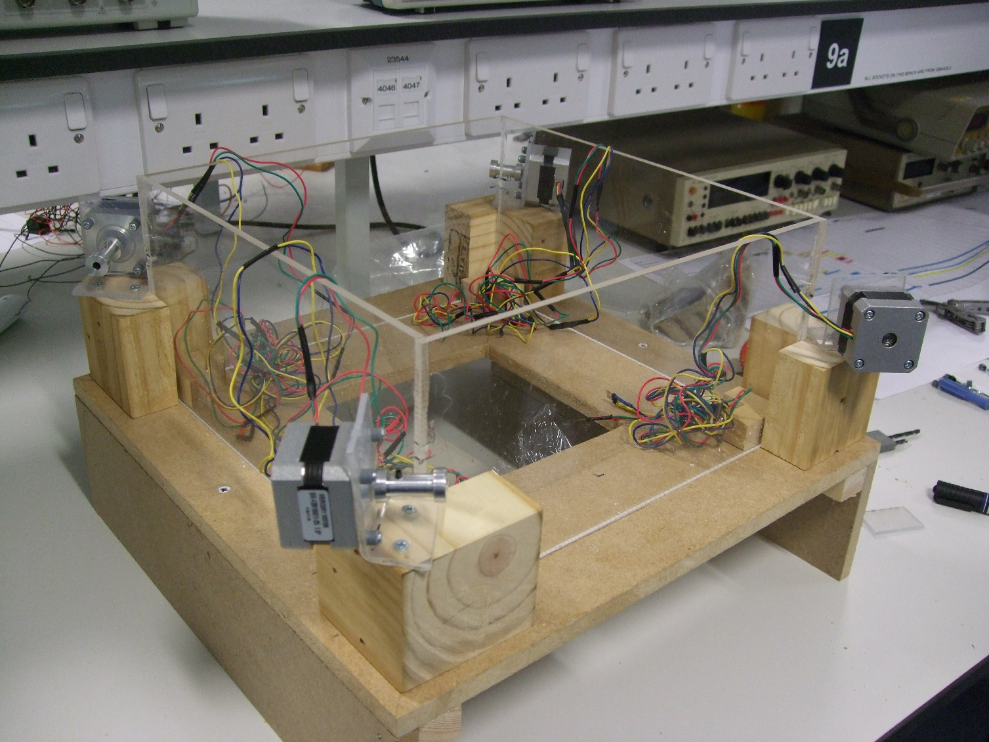
Introduction
Notes:
(Ethan)
Introduce project:
Who NES are
what have we been asked to do

Slide 3
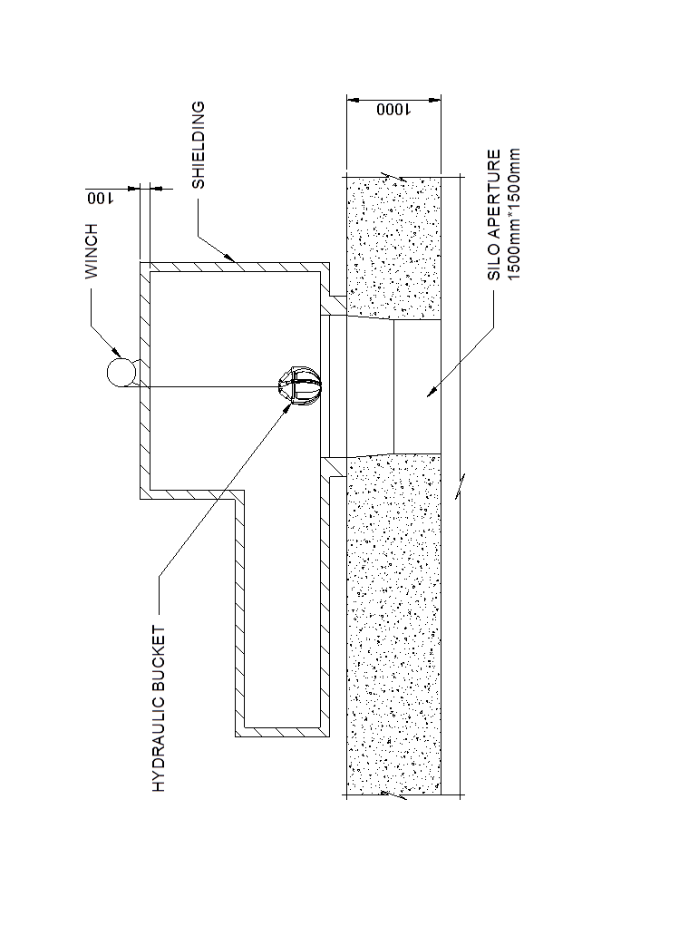
Project brief
Notes:
(Nic)
Currently, there is nuclear waste from the early days of the nuclear industry in the UK (1950s-60s) buried in concrete silos underground. NES have a scheme where a hydraulically operated bucket suspended from a wire rope winch retrieves the waste to be disposed off. Access to the silo is through an aperture in its roof and the system is surrounded by a shielded box which can be moved across the different silos. However they have no way of positioning the bucket within each silo, and so to adequately clear the waste a wire rope positioning system is necessary.
Our brief was to design such a system.

Slide 4
System Requirements
System capable of delivering the rope to 12 programmed positions.
Require no electrical components to be placed within the shielded box.
Minimum amount of equipment in the shielded box without compromising its shielding.
Components should be replaceable without the need to enter the shielded box.
Little maintenance required.
Notes:
(kathryn)
Little/No maintenance shall be required and Components should be replaceable without the need to enter the shielded box.
- This means it needs to be very durable and reliable as replacing parts inside the shielding would be extremely hard to do; workers cannot be sent to remove the waste due to health and safety risks. Hence, NES must replace parts remotely.
- Therefore, the rope positioning system cannot be too complex as with more components there is more of a chance of failure, and a high cost if it broke.
Place the minimum amount of equipment within the shielded box.
- Most equipment to move the wire rope must be on the outside of the shielded box and so this requires a way of entering it without compromising its shielding.
Be a powered system capable of delivering the rope to 12 programmed positions.
- These programmed positions must cover as much area as possible.
Not require any electrical components to be placed within the shielded room.
- The radiation emitted from within the silo will destroy any circuitry inside the shielded box. This radiation renders any electronics that are inside the shielded box inoperable. Therefore no electrical components can be placed inside the shielded box.
Not compromise the shielding of the shielded box.
- Due to the high risk associated with radiation levels found in the silos, there must be constant shielding.

Slide 5
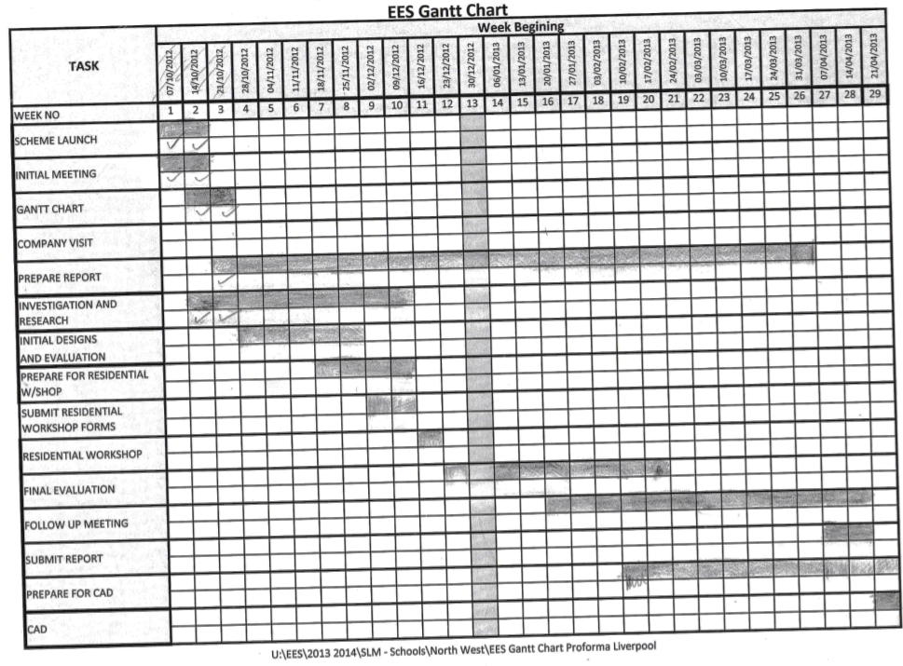
Planning
Notes:
(ethan)

Slide 6
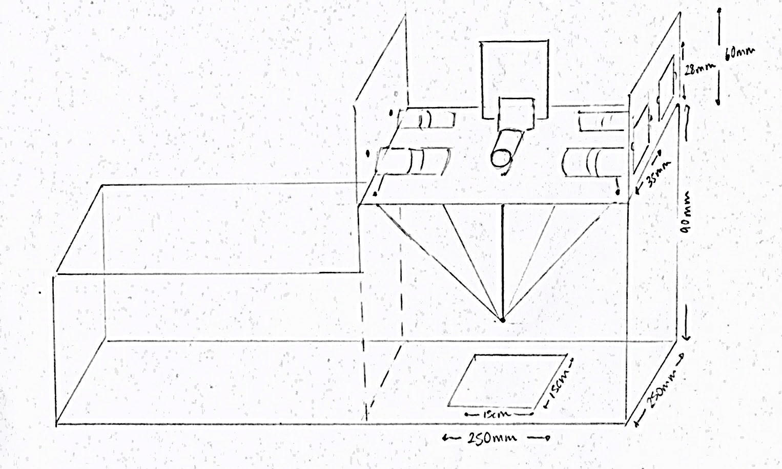
Initial Idea 1
5 motors running in tandem pulling the ropes.
Rope attached to the central plate would enter through holes in the corners of the shielded box.
Notes:
(ethan)
As part of the project specification by NES, we were required to complete 3 concept schemes. For this, each member of the team brainstormed individually and then brought the ideas together in multiple meetings. The raw ideas were refined to produce 3 initial ideas which are going to be described in the next 3 slides.
Initial idea 1:
5 motors running in tandem with each other in order to reach several desired positions within the silo. In an overhead view, this would work by placing 1 motor on each corner of the ‘shielded box’ above the silo, and the 5th motor centred above the silos’ aperture, to control the depth of the centre-piece. As the motors turn, a rope that would enter through holes in the corners of the shielded box, would be pulled. These ropes would be attached to a central plate which would hold the weight. This seemed like the optimal solution to the problem as it fitted the given company briefs’ specifications, and could of easily met the desired ‘pre-programmed positions’ requested by NES, and maybe even exceed the expected the number. It keeps the minimum amount of equipment inside the shielded box, as the motors are on the outside, and wouldn’t require much maintenance.

Slide 7
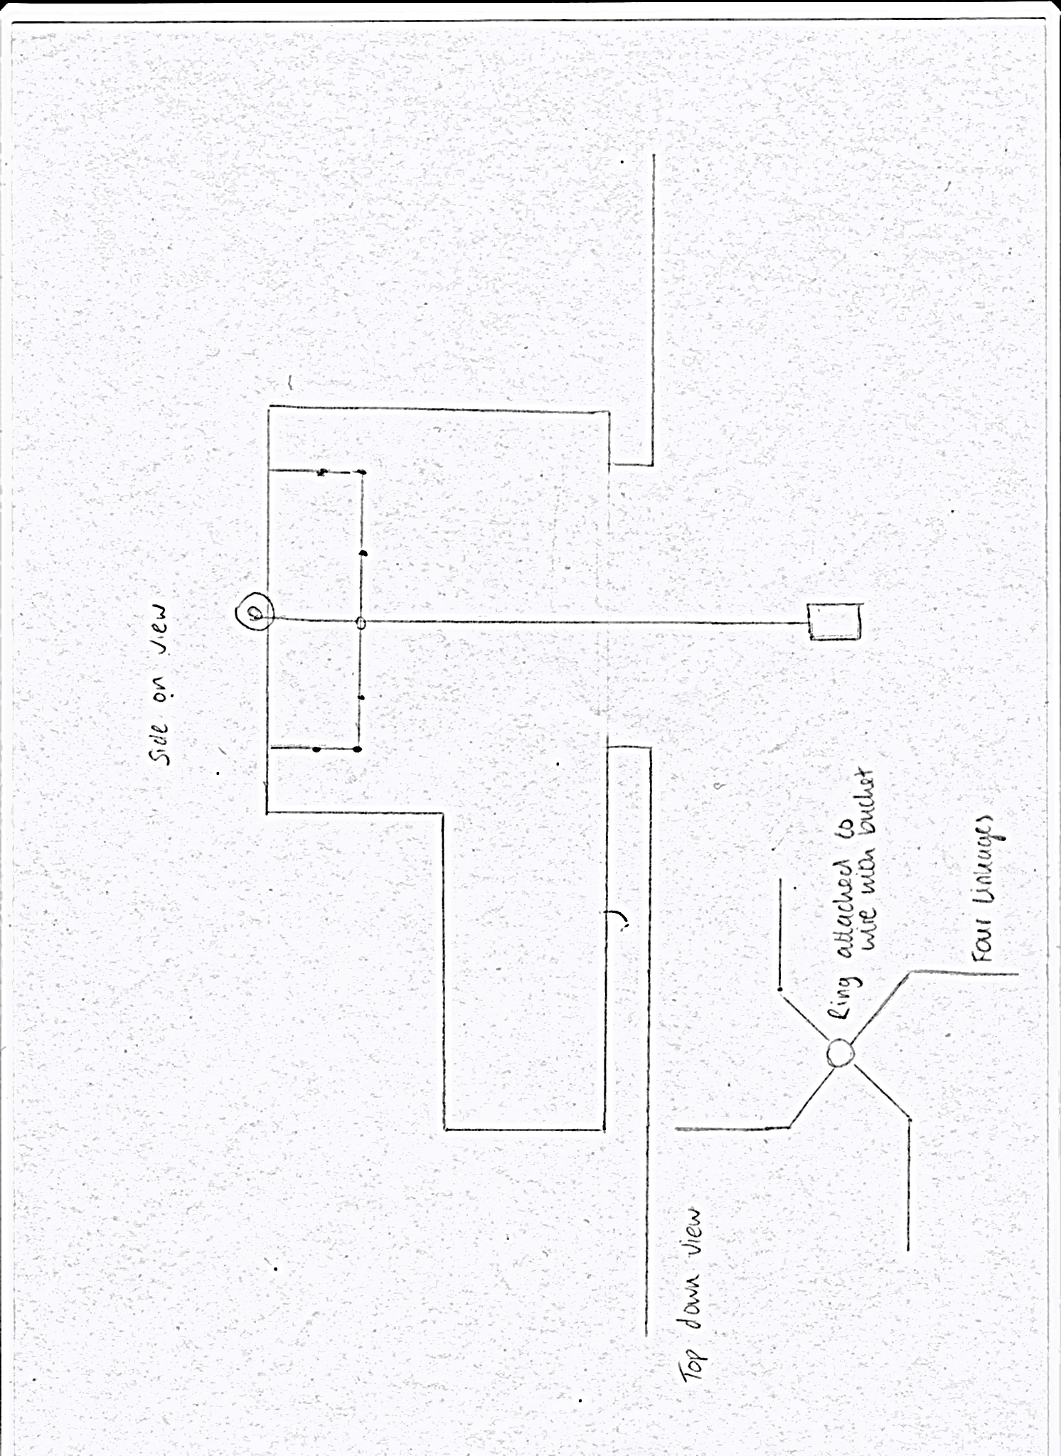
Initial Idea 2
Clip of spirograph here
Use a bar linkage mechanism
Spirograph or Harmonograph idea with the mechanism inside the shielded box and a winch on the outside to move the bars into positions.
Notes:
Initial Idea 2(Kathryn):
A proposed solution was to use a bar linkage mechanism to manipulate the rope on the wire into 12 pre-programmed positions. This would work like a Spiro graph or Harmonograph with the mechanism inside the shielded box and a winch on the outside to move the bars into positions. As in the video, the 12 programmed positions would be situated along the shape the system described.
This fits the brief we were given as it is completely mechanical, and so is not subject to electrical malfunctions due to the radioactivity. It can however be automated from outside the shielded box to avoid this and still be a computer controlled device. It can theoretically achieve 12 pre-programmed positions with the right arm/links configuration.
However there are limitations to this idea. It would be a large device to install into the shielded box and therefore be expensive and difficult to decontaminate or dispose of if it needed repairing or fixing. To achieve 12 pre-programmed positions that adequately covered the area inside the container and reached the corners, would involve linkages that once unfolded to a maximum length would be longer than the dimensions of the container. To solve this problem would require too much technical ability that we did not have in this subject or that was attainable in the time frame we had.

Slide 8
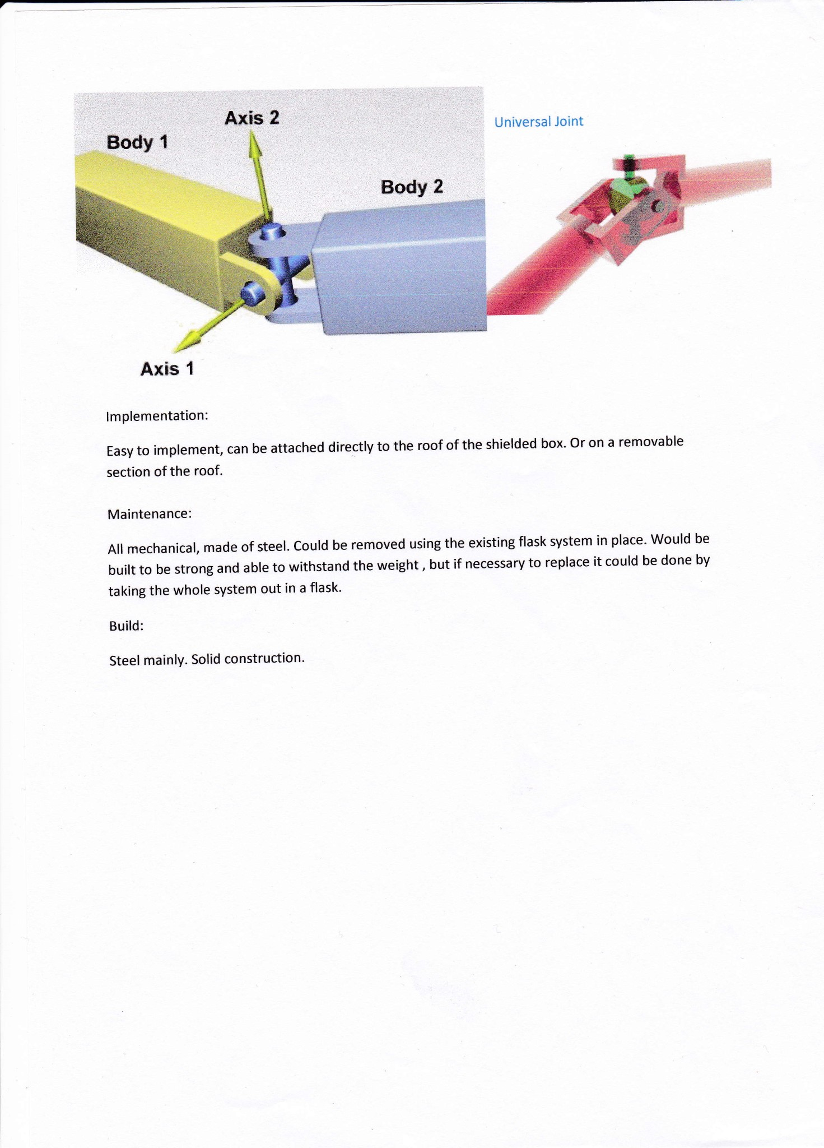
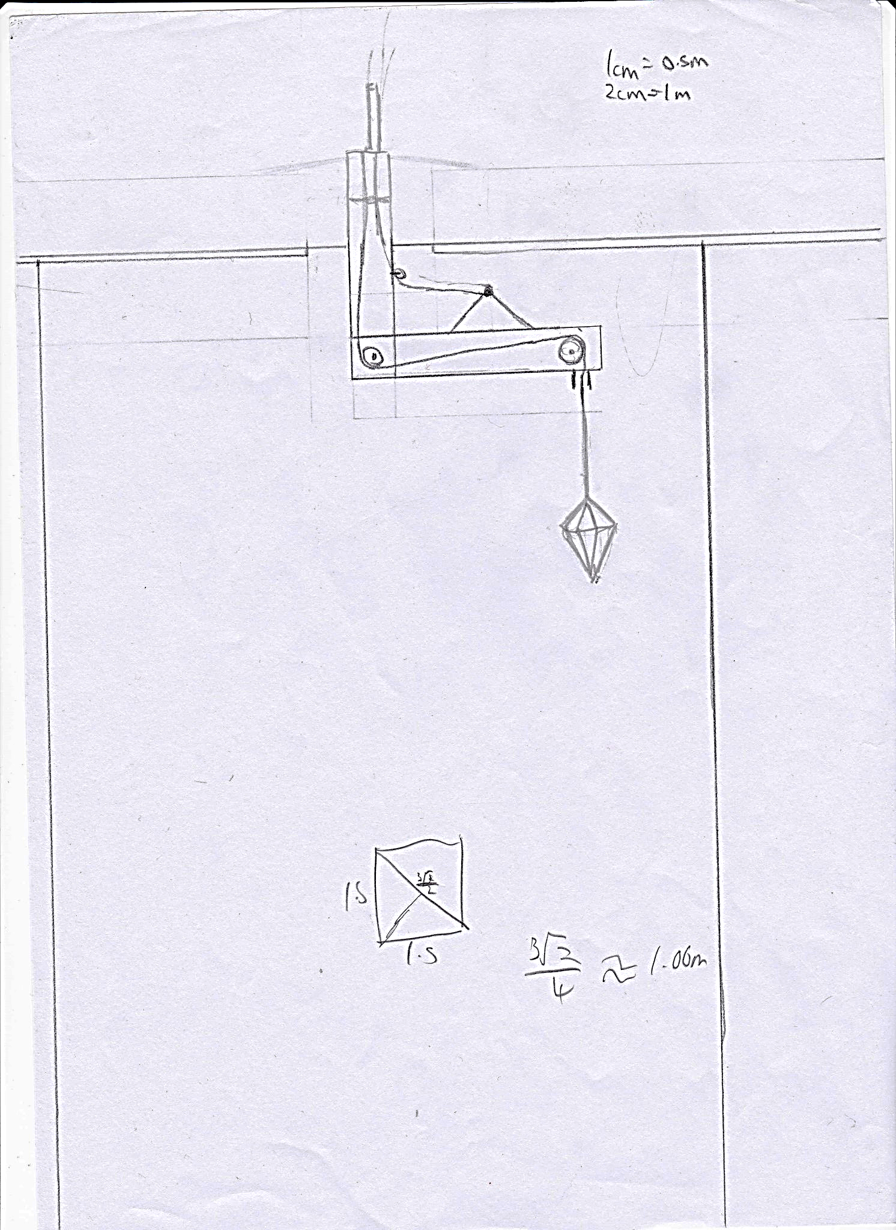
Initial Idea 3
hydraulic arm that was made up of two movable parts
Notes:
Initial Idea 3(Jacob):
The third proposed solution involved a hydraulic arm that was made up of two movable parts. A vertical part which the main rope went through and a horizontal beam that was attached to the bottom of the vertical part through a gearing system and a universal joint. The rope passes through the horizontal part of the arm, and out the end. This arm can then be rotated about the vertical part, the horizontal arm can also be raised up and down around the joint with . This combination allows for any position inside the shielded box as by raising and lowering the end of the horizontal and rotating it, the end (and hence the rope) can reach any position within a circle around the rope entry position. The circle has a radius of the length of the horizontal arm. This allows any position to be reached inside the aperture, and meets the requirement of 12 positions. This solution has no electrical components inside the shielding, and doesn’t compromise the shielding thus meeting the requirements. However this solution doesn’t place the minimum amount of equipment inside the shielded box, and this is its main flaw. It includes a complicated gear mechanism with a universal joint supporting the weight of the horizontal beam. Therefore when scaled up it would be prone to a lot of failures and hence create a lot of extra waste for NES to deal with.

Slide 9
Final Design
Idea | Feasibility | Ability to Reach 12 Programmed Positions | Min. Equipment Within Shielded Box | Little Maintenance/ Replaceable Components | No electrical Components Within Shielded Box | Total/50
1st Idea | 9 | 10 | 8 | 7 | 10 | 44
2nd Idea | 7 | 5 | 6 | 7 | 10 | 35
3rd Idea | 6 | 7 | 6 | 7 | 10 | 36
1st Idea most viable.
5 motors fixed to the sides of the container using L brackets pulling ropes attached to a central plate.
Notes:
(Jacob)
Need to explain how this design matrix is how we decided on the final idea, and describe the use of the test box to determine the motor placements.
After consulting with the engineers at a meeting, a joint conclusion was reached with their professional input. It was decided that the first solution, the five motor solution, was the best proposal. This solution was preferred because it was simple, could be modelled, and met and exceeded the requirements of the brief.
A basic model was the best way to prove the solution was the simplest and most viable. This involved a simple container with a weight and four ropes. The ropes were able to be moved from each corner simulating the motors. The intention was to position the motors on top of the container to move the ropes from above, however the model showed that the weight would be pulled at an angle. This would lead to inaccuracy in it’s position. After adapting the concept and re-modelling it by pulling the ropes from the side, the weight was pulled straight and so brought the conclusion that the motors should be mounted on the side of the box.
This proved we can get to any position inside the shielded box and our solution was valid and viable. After providing the evidence to the engineers, permission was granted to model that specific solution. This allowed the team to make technical drawings, CAD designs of the model, and start to send purchasing requests to NES for the components necessary.

Slide 10
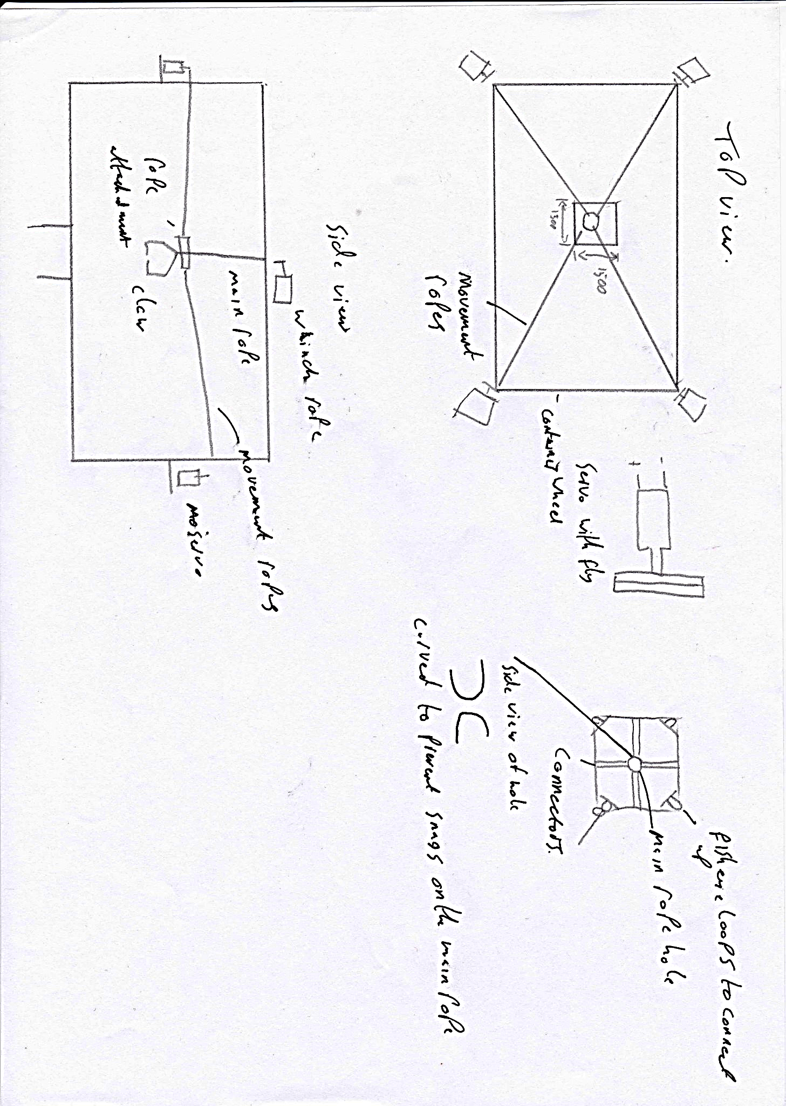
Final Design
Image (cad drawing?)
Image needs updating
Notes:
(Nic)
dimensions of the shielded box were set to 300mm by 300mm x 150mm (WxLxH), and the aperture would be 150mm x 150mm centered in the shielded box.
Due to its cost and transparency 5mm clear perspex was used to model the shielded box
The MDF base support legs as its cheap, sturdy and easy to assemble
For the stands holding the motors at the corners of the box, we decided to use cut blocks of pine wood, as its strong enough to support the motors, easy to drill through, and relatively light, as to not place too much weight/strain on the base of the model
Perspex was used to create the motor holders/brackets. This was because perspex can be easily molded into the desired shape of an “L” bracket by using heat, which was done at liverpool university.

Slide 11
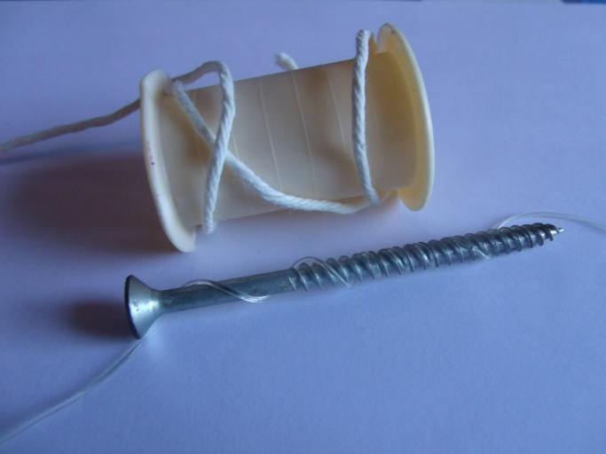
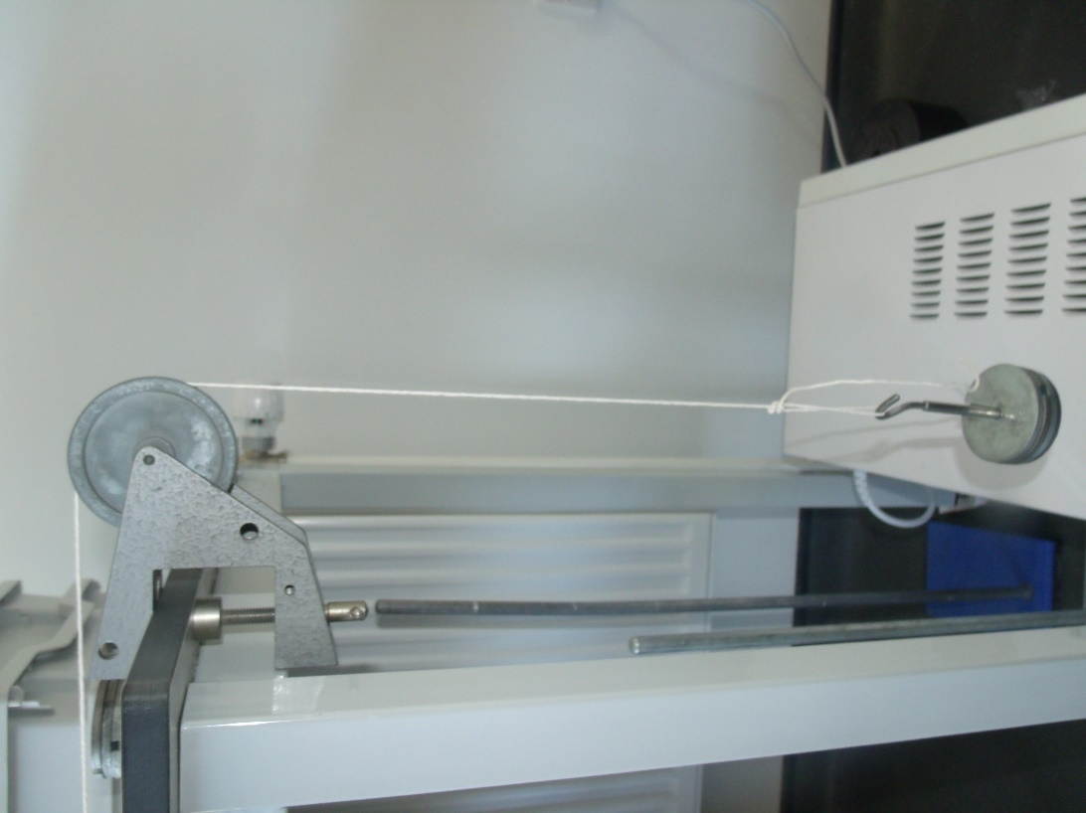
Research- Wires
Sketch of spool made at liverpool
Needed to be: thin, flexible, strong, hold tension and not hold its shape once unravelled.
Materials tested: Darcon, string, yarn, thread, guitar strings, fishing wire.
Notes:
(Kathryn)
Once we started to concentrate on the details of the model, research was required into what specific materials were needed for different tasks, and how each part of the box would work.
To select which wire was best to use, research into materials such as Paracord, electrical wire, Dacron, string, yarn, thread, guitar strings and fishing wire was done. The wire needed to be thin, flexible, and not hold its shape when unravelled. It also needed to be strong, and hold tension. Research into different gauge nylon guitar strings revealed that although strong and easily obtainable, all of them held their shape and so were not suitable for winding round the rope drum. String and yarn proved to be too weak and did not withstand the tension the motors were capable of. After research and testing, using a pulley and weights, normal wire was the best option as it was thin enough to be flexible but strong enough to provide tension and support the weights.
As the motors pulled the weight into different positions, the wire needed to keep tension and spool around a device. Initially using a threaded screw seemed the best solution, as the wire would not layer over itself, which could have an effect on how much the motors needed to turn to move the weight to a specified point. However, this effect was negligible in practise. The concluding solution was to use an unthreaded spool, and let the wire overlap. This could be made precisely by the engineers in Liverpool and effectively wind the wire.

Slide 12
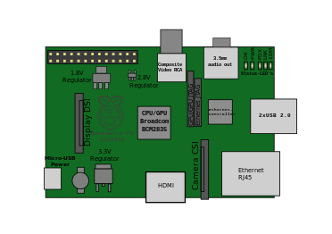
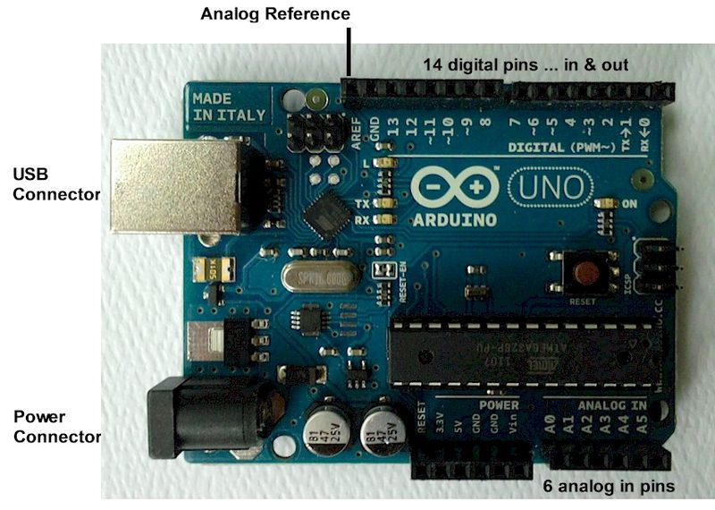
Research- Microcontrollers
Controller | Sufficient Inputs/Outputs | Sufficient Output Power | Pre-built Libraries | Within Budget
Arduino | Y | Y | Y | Y
Raspberry PI | N | N | N | Y
Notes:
(Ethan)
For the RRPS to work it would require a complex control system with the ability to be programmed and have a basic input and output system. For this we had 3 main choice to choose between; they were the Arduino, The Raspberry Pi and a PLC unit/s. A PLC is a programmable logic controller that uses logic to control the inputs and outputs. This method would be expensive and the team lacked experience in the use of PLC’s, and so they were ruled out. The team found that the number of input and outputs on the raspberry pi were limited and the output power of each pin was also lower than what was required. We also had a lack of experience in the programming language compatible with the Raspberry Pi, and so were not comfortable with using it. Also, as the project requires the ability to control stepper motors, there were no pre built libraries to help the programmers to control the stepper motors so it would require the programmers to build their own libraries from scratch, which would significantly and unnecessarily delay the project.

Slide 13
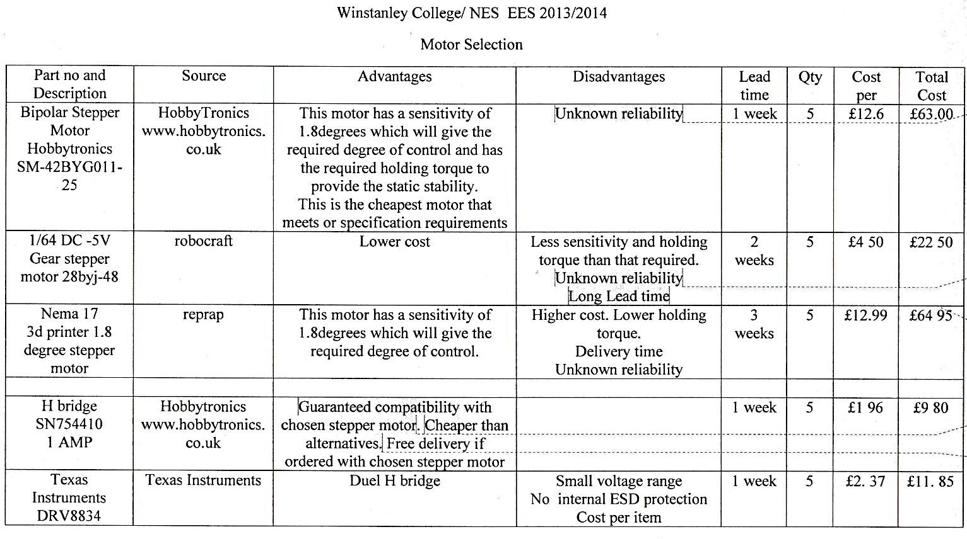
Research- Motors
Notes:
(Nic)

Slide 14
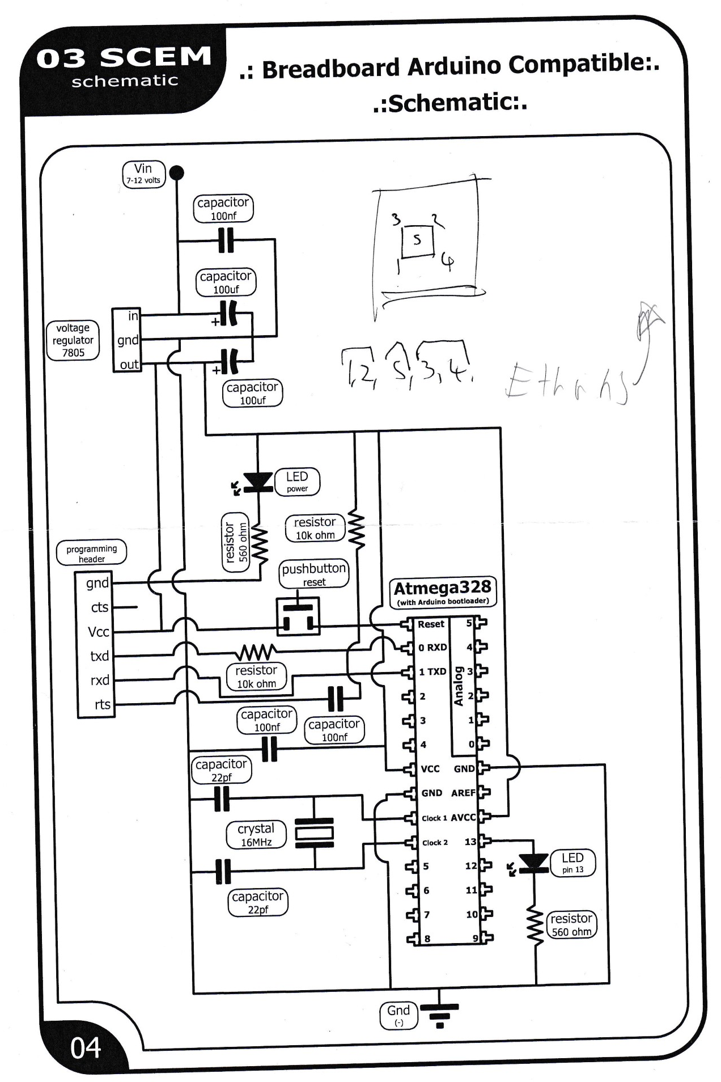
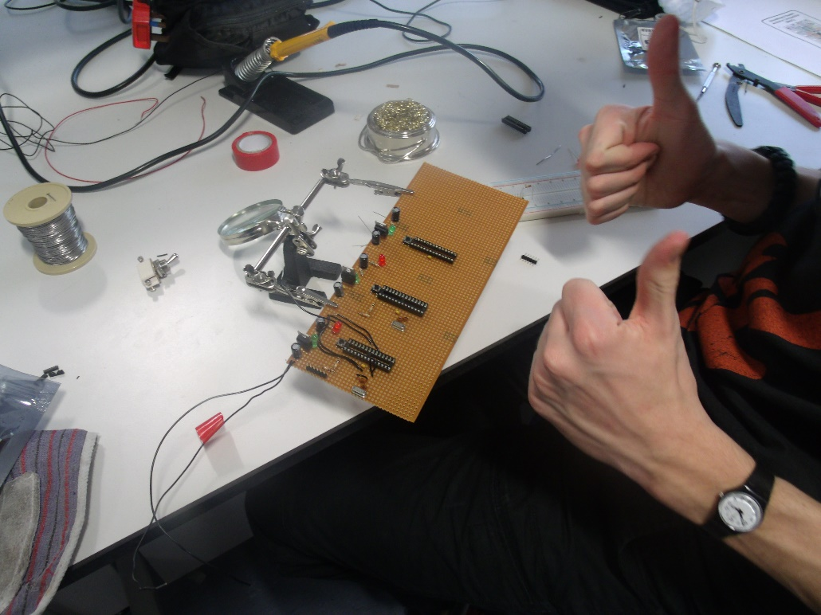
Circuitry
CIRCUIT DEISGN.
Notes:
(Jacob)
Since there was a need to drive 5 motors, the circuit had to comprise of 3 arduinos and 5 h-bridges. It was decided that a proper electrical schematic had to be designed to reduce the chance of making a mistake. The circuit design required a lot of research into programs that can be used to make schematics, as well as some components. Including filtering capacitors for power rails.
Most of the circuit design was adapted from open source designs for the ATMEGA328P-PU chip, and changed to fit the form factor of our stripboard and to suit our requirements.
. The main changes were having three arduino chips that had to be isolated, the addition of five h-bridges, and three separate and isolated power rails. Each arduino required it’s own 5V supply that came from a VRM (voltage regulator module) which took an input of 9V-12V and outputted a stable 5V. This meant there had to be an input power rail of 9V-12V.
The H-bridges each took 4 power inputs, one that powered the logic gates and two that enabled each half of it, and one that powered the outputs. After consulting the data sheet on the h-bridges it was found 5V would be necessary, so a separate 5V power rail had to be provided.
Each H-bridge required a power supply for the motor, and since each motor required 12V at up to a current of 0.3 amperes each (1.2A in total) there was a need for the third and final separate power rail. This power rail only powered the motors, and it has a capacitor across it and a ground rail to reduce the noise that is created due to the operation of the H-bridges.
To communicate between the computer and the arduino chips, an FTDI header had to be put on the board for each arduino. It is a 5 pin header that is wired up to the RX and TX pins of the arduino and to the reset pin (through a decoupling capacitor), and the ground was connected to the ground of the arduino power circuitry to ensure both the FTDI chip and Arduino had the same reference point. The FTDI chip is connected to the computer with a mini USB cable; this allows for serial communication to and from the arduino and the ability to upload ‘sketches’ (programs/software) to the arduino.

Slide 15
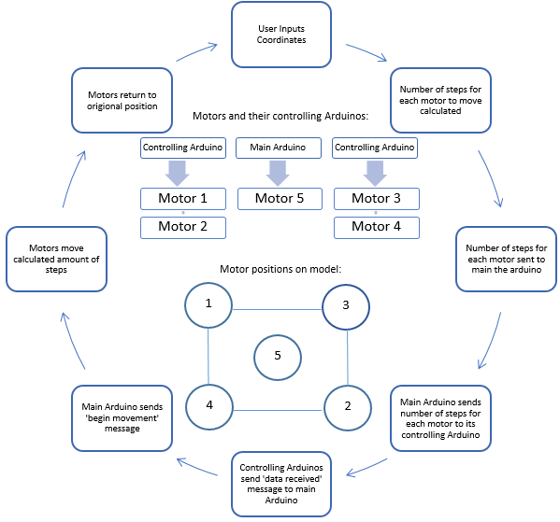
Programming
(0,300)
(300,300)
(0,0)
(300,0)
Notes:
(Kathryn)
Research was conducted on inter-Arduino communication by sourcing the Information from the Arduino site. The best method found was to use the wire() library as this was similar to other methods previously used by members in the group and was simple. However for this project this library was inappropriate as the correct order of communication could not be achieved by running two Arduinos off a central ‘master’ using the wire library. Only one message could be sent at a time. Changing to software.serial() enabled effective communication between the three Arduinos so that messages were sent from the central Arduino to the others at the same time.
To be able to program the Arduinos, basic coding skills in this area were needed. To gain experience the Arduino website was used to reference key terms, syntax and example codes. Other websites and forums were used to explore multiple ways of solving similar problems which would contribute to the final code. Methods such as Pseudo code helped to model what the code needed to achieve in what order, and flow charts showed which message was sent by which Arduino and when it was received.

Slide 16
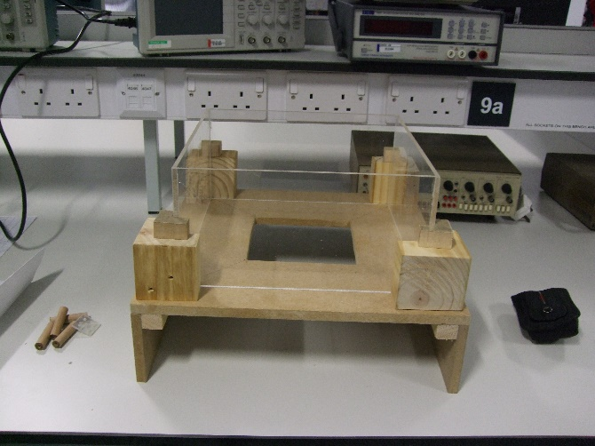
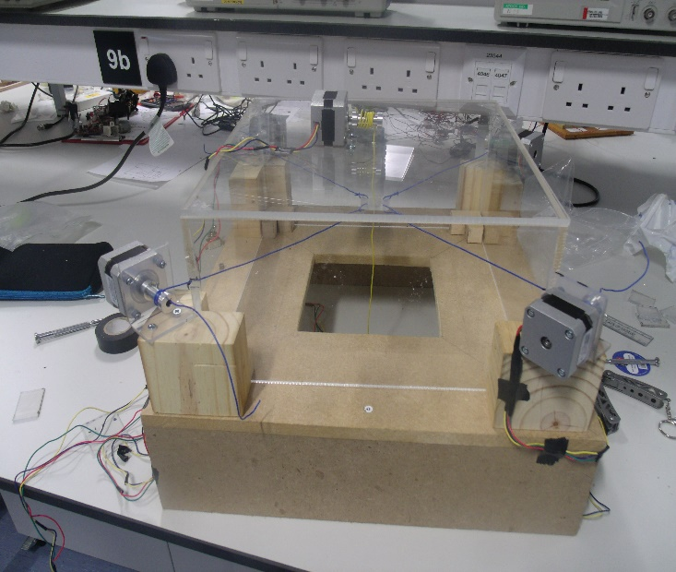
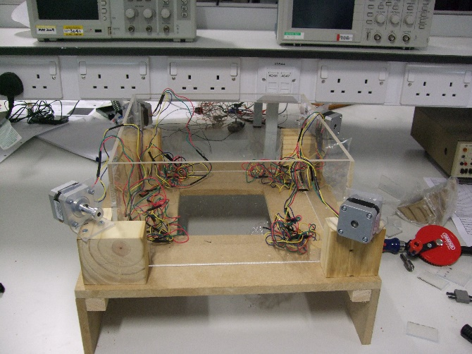
Liverpool Workshop
Notes:
(Ethan)
Having the chance to go to Liverpool and use the universities equipment and resources meant we could make much progress on the model.
We intended to build the box completely and have all the winch drums/spools created.
We intended to finish the program for the arduinos and make significant progress on the main program to calculate how much each motor should move based on user inputted coordinates. We also planned to have the circuit board built and tested.
Testing

Slide 17
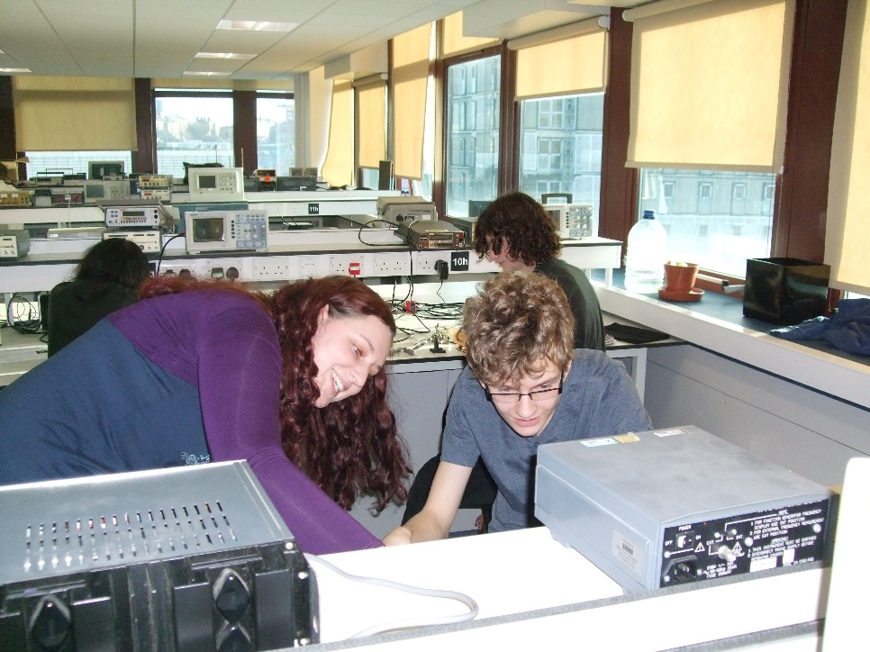
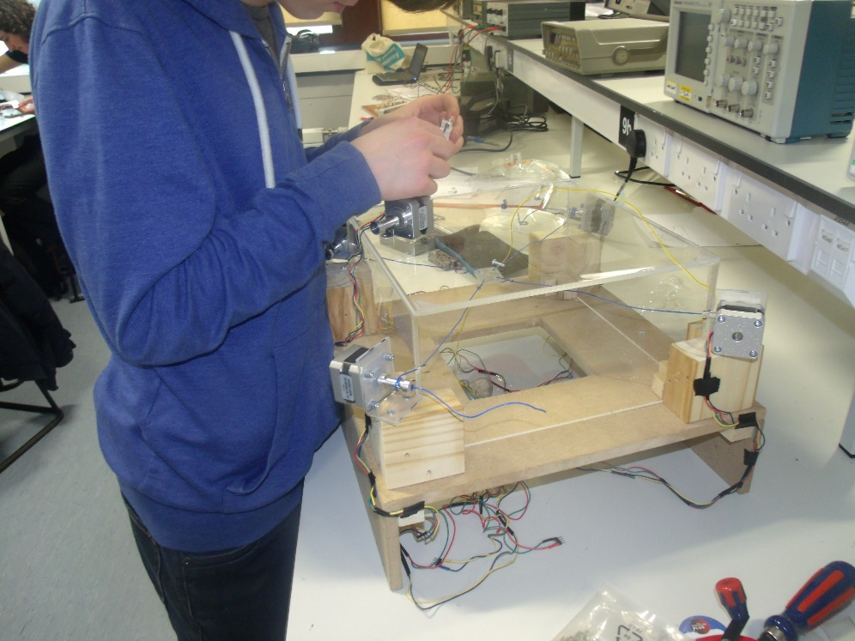
Liverpool Workshop
Notes:
(Nic)
By the end of the trip to Liverpool we hadn’t completely everything we had set out to. The program for the Arduinos was finished but could not be tested as the circuit hadn’t yet been completed and tested itself. The box had been built and all components attached together, and the motors had been prepared for connecting in the circuit. The main program to calculate the motor movements wasn’t completed either however this was not crucial at the time as it could not be used until the physical elements of the project were completed.

Slide 18
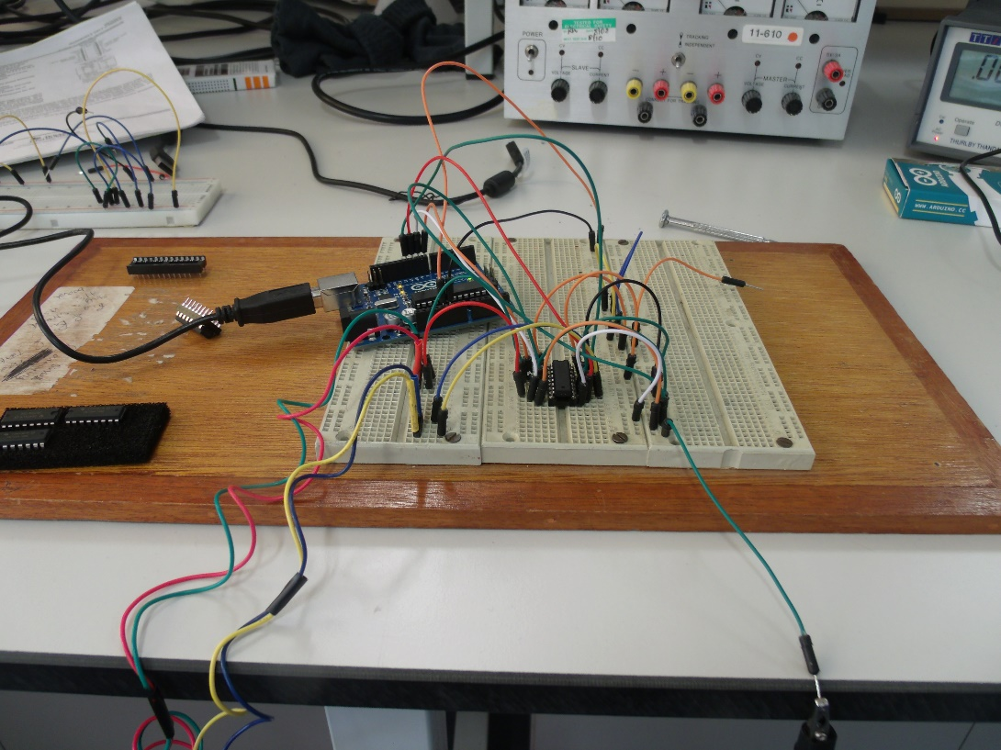
Electronic Testing
Simple circuit to determine whether the Arduino could control two motors together.
Multimeter used in continuity testing to check short circuits.
Voltmeter used to test the voltages were correct at each pin.
Simple programs uploaded onto the Arduinos to flash a red LED ensuring they were programmable.
Notes:
(Jacob)
A small test circuit was built to test the concept. A simple breadboard circuit consisting of two H-bridges (motor drivers), and an Arduino Uno was built. Two motors could be tested at a time. The Arduino Uno was programmed with simple program that would turn motor 1 a full revolution clockwise, and motor 2 a full revolution anticlockwise. This would test the ability of one arduino driving two motors through two H-bridges. Testing all 5 motors proved that a single arduino can run two motors in opposite corners with no delay confirming our proposed solution was viable. It also confirmed all five motors were working and could support a mass of 100g, which was a requirement for the model set by the engineers.
To test the circuit initially, a multimeter was used in continuity testing mode to check for any short circuits that could damage any of the arduino ATMEGA328P-PU chips, or the H-bridges. After this, power was connected up to the board without any chips in place and a multimeter in voltmeter mode was used to check the voltages were correct at each pin. This ensured that no chips would be damaged after they were put in. Finally, after ensuring that the chips would be safe from any shocks/ static discharges or short circuits they were inserted into the IC holders and the board was powered.
After powering the board, each arduino had a simple program uploaded onto them, that would flash the red LED connected to digital pin 13 ensuring the arduino was in working order. A program was then loaded that would just turn the motors connected to the arduino to ensure that the connections between the arduino and H-bridge were good.

Slide 19
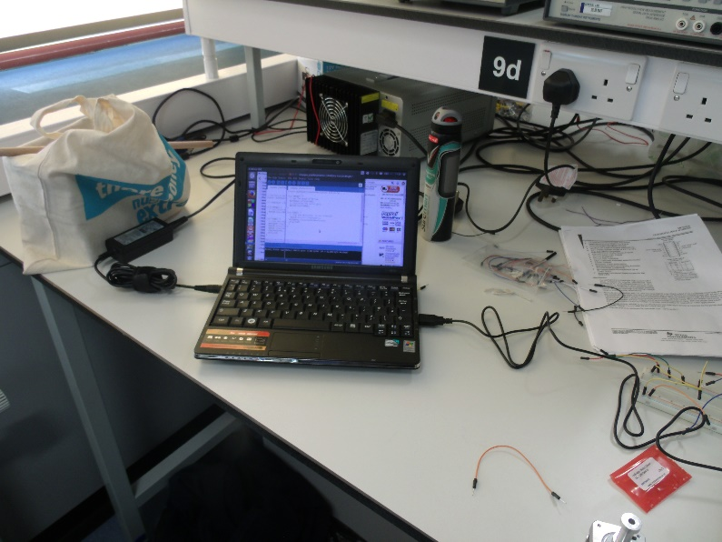
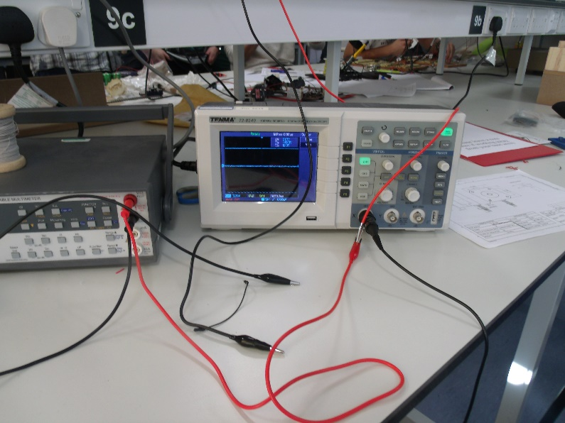
Software Testing
Testing the communication between the computer and circuit revealed that the software would work better on a windows system
Testing with hypothetical values to determine whether the correct outputs were given for the motor movements
Testing of the communication between the computer software and Arduino revealed that they were not congruent and there were many small problems with consistency.
Notes:
(Kathryn)
Whilst developing the hardware in Liverpool University the software was initially planned and written. Initially it was written for a Linux based system however later it was found out that the software would work better on a windows system. This was discovered while testing the communication between the computer and the circuit. This required a complete rewrite of the computer side of the software.
Initially, after writing the software it was tested with hypothetical values by hand to find that the correct outputs were given and to ensure the computer software would send the correct signals to the circuit board and the circuit board would respond correctly (also known as ‘dry testing’) . The dry testing appeared to show the software would work fine. However, while testing the finished circuit and software in unison, there were problems found with handshaking and communicating between the computer software and the main Arduino. This resulted in a lot of debugging and reprogramming of both the computer software and the software on the Arduinos.

Slide 20
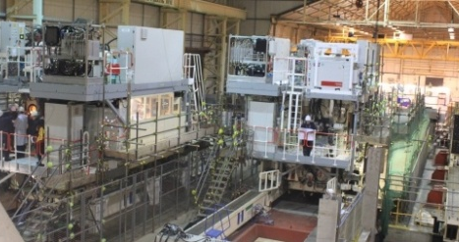
Implementation
Use DC motors and a custom gearing system instead of stepper motors
Series of PLC’s instead of microcontrollers
Steel anti-twist cable instead of wire
Notes:
(Nic)
The proposed solution used stepper motors to move the ropes and the bucket around. Currently , there are no stepper motors with sufficient power/torque output or accuracy (in terms of steps per revolution) that would be required at NES and to build their own would be extremely costly. It is therefore recommended that NES use conventional DC motors and a custom gearing system that can finely control the output and hence the position of the main rope. A feedback system would also be required, allowing the operator to know the rope’s exact position.
For the control system it would be recommended for NES uses a series of PLCs’ (Programmable logic controllers). These are industrial controllers for very specific purposes, are easier to program in an industrial environment and are universal for control. NES would require a few PLCS to control all of the motors in tandem and it also allows for a safe environment.
For the actual ropes used in the system, NES may need to use thick steel anti-twist cable to move the plate in the container. This is so that the cable can withstand strain and stress over a large amount of time without breaking. It also reduces risk of breakages.

Slide 21
Final Solution
Clip of weight moving here

Slide 22
Acknowledgments
We wish to extend our appreciation and thanks to the following, without whom we would not have had this experience.
The Engineering Development Trust
The Engineering Education Scheme
Nuclear Engineering Services (NES), for their sponsorship
University of Liverpool, and their staff for the extensive use of their facilities
Winstanley College, especially Mr Geoff Woodward
Notes:
(Ethan)

